Slide 1
Smart recycling bin

Slide 2
Intriduction-
-There is no doubt that rubbish is agreat danger for individuals and society
-Egypt suffer from banking rubbish in huge amounts.
accourding to statistics 55000 ton of rubbish produced daily..
factories is the cast of import separable rubbish to use it in recycle 15 bilion
-Althogh there are only four separting rubbish centers all over Egypt.
people still throw rubbish in roads.

Slide 3
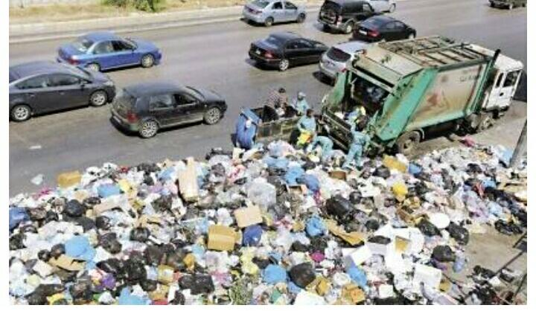

Slide 4
Objectives of project
Attracts people to throw rubbish in smart recycle bin by its good design
Separating rubbish automatically
Keep the environment clean
Provide factories by separarted material which used in recycling

Slide 5
Details
The biggest challenge of this project was that we could not find one sensor that would accomplish everything we wanted to,so we had to do alot of research and compaine different sensors with image processing language to get the results that we wanted
Automatic cover
We used Ultrasonic sensor to measure the destance between people and bin then send signle to servo motor to open the top cover

Slide 6
Separating operation
First we use inductive proximity sensor to detect metallic waste
Second we use image processing language to detect plastic and and organic waste
Finally we used loatd cell for distinguishing between glass pieces and paper waste

Slide 7
Smart application
We design smart application which can send to user text message when it is full and needs to be emptied

Slide 8
Developing
Make network between all smart recycle bin to sind updates to the company responsible by using IOT
Make robot to collect rubbish from street and separate it

